Slide 1
Microservices Architecture MSA
22.11.2017
MSA overview
Ramón Tomás
David Sanz

Slide 2
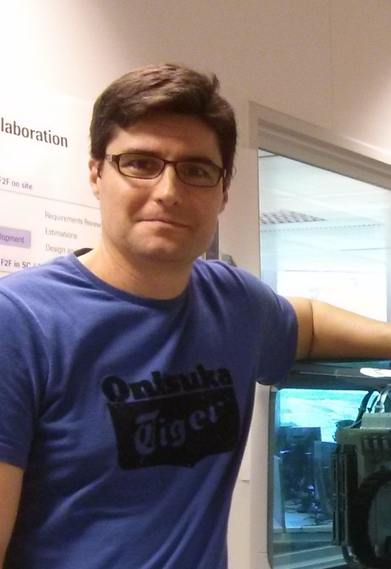
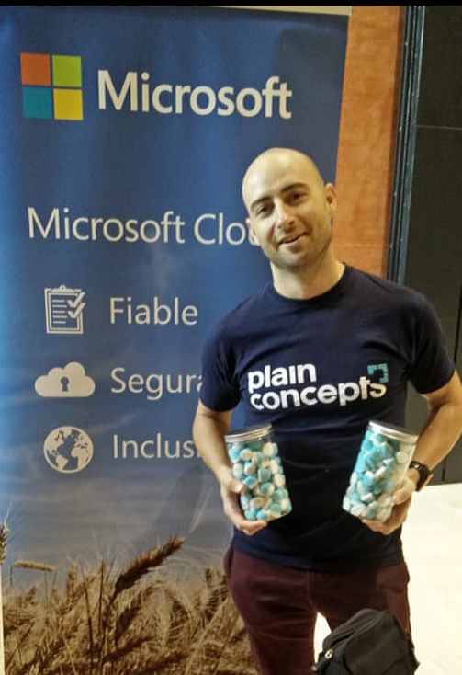
Ramón Tomás
David Sanz
Consultant
Software Development Engineer
Software developer
Scrum Master
Experience in pharma diagnostics, homeland security and travel industries
https://www.linkedin.com/in/david-sanz/
dsanz@plainconcepts.com
Full-stack developer
Expert in .NET & Cloud solutions
rtomas@plainconcepts.com
@dsrodenas (twitter)
@ramon_tomas84 (twitter)

Slide 3
Best Practices & Antipatterns
Resilience
Infrastructure Automation
Health Monitoring
Ready to Prod
#MicroservicesEvent

Slide 4
1. Best Practices & Antipatterns

Slide 5
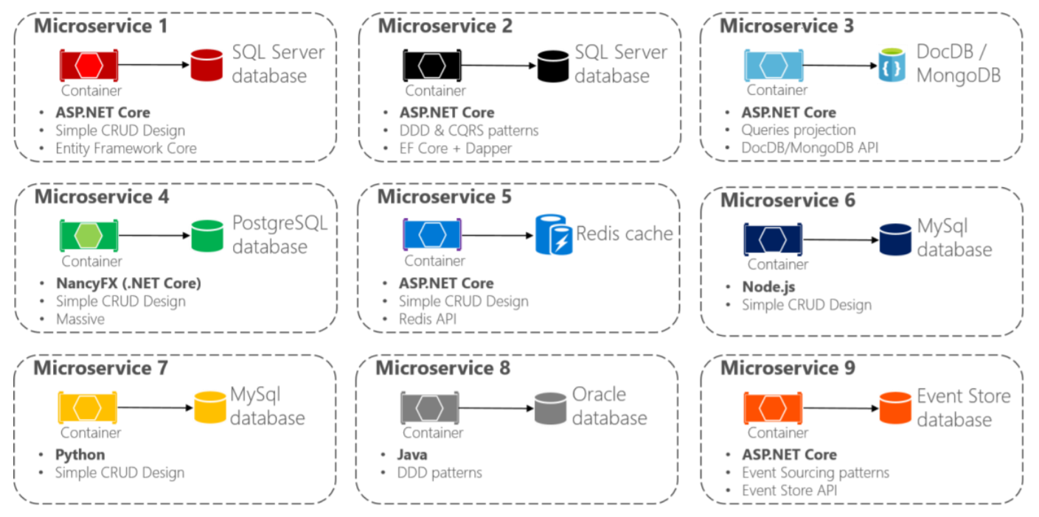
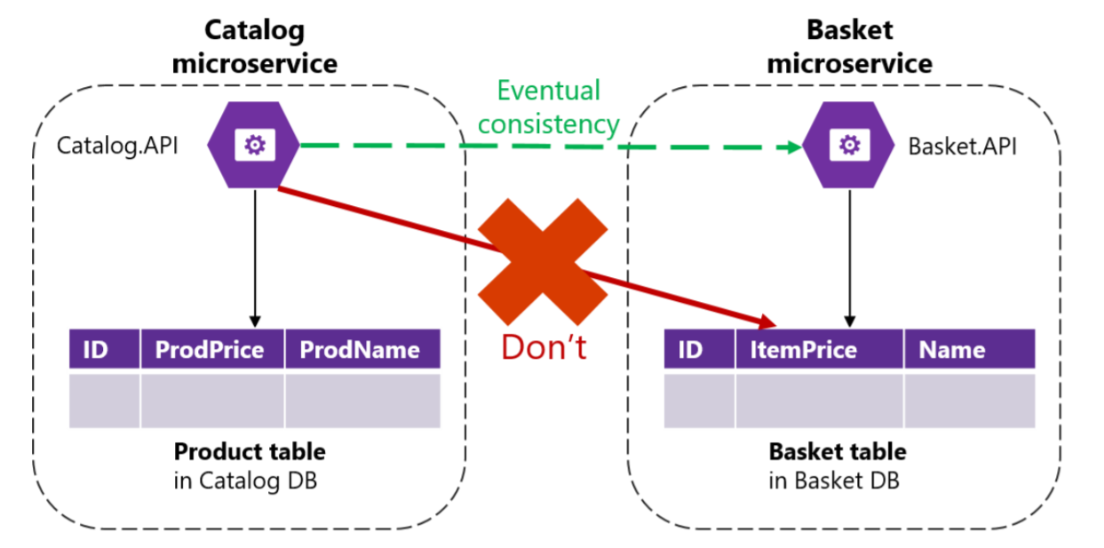
Decentralized Data
Each microservice owns its own data source
Data owned by a microservice is private
Data can only be accessed by its API
Polyglot microservices and persistence
Encapsulating data ensures loose coupling

Slide 6
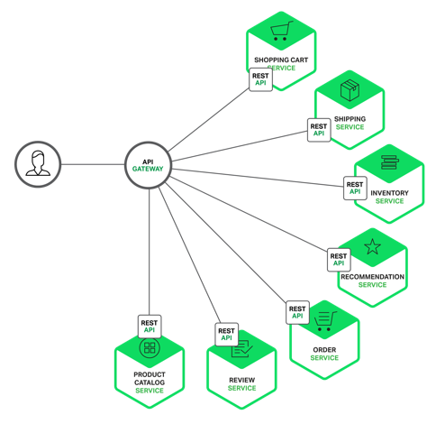
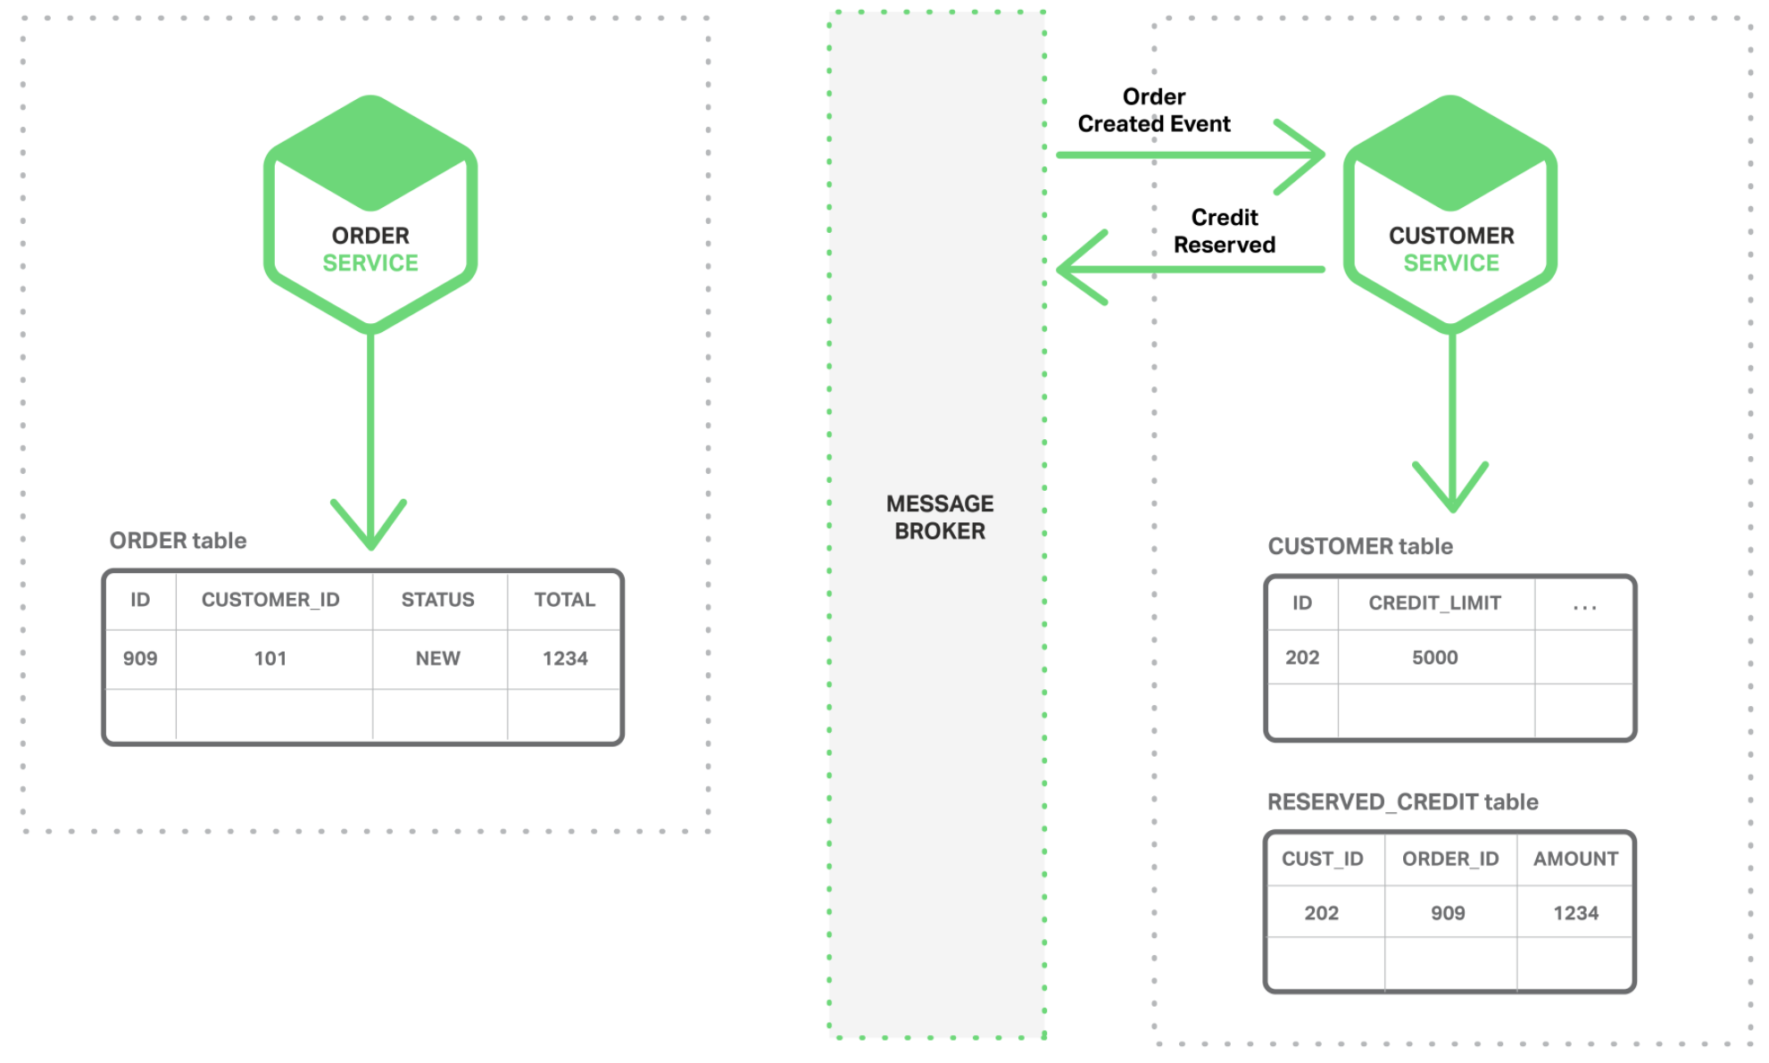
Decentralized Data
Avoid chatty communications when retrievieng data from multiple microservices
Use fine-grained Api Gateways or read-data models for data aggregation
Trade-off between consistency and availability in distributed systems (CAP Theorem)
Ensure eventual consistency in business transactions

Slide 7
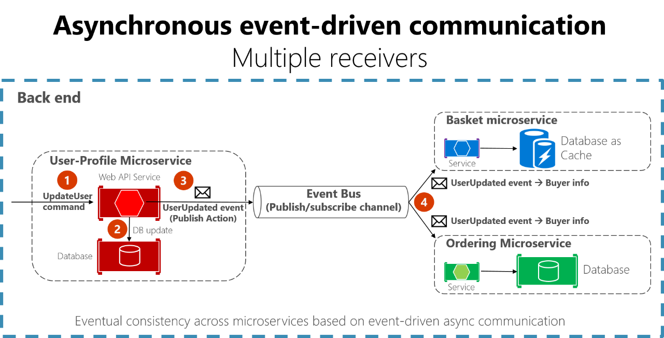
Eventual Consistency
Avoid distributed transactions
Scalability and high availability
Assume a system inconsistency window
Event Sourcing or Outbox patterns provides atomicity

Slide 8
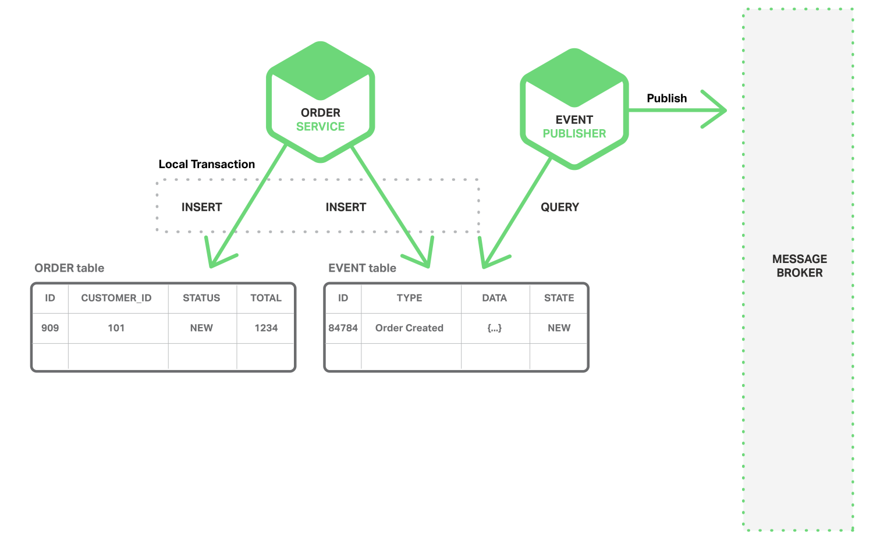
Outbox pattern
Multi-step process involving local transactions
Atomicity with business entities and events
Separate service to publish events

Slide 9
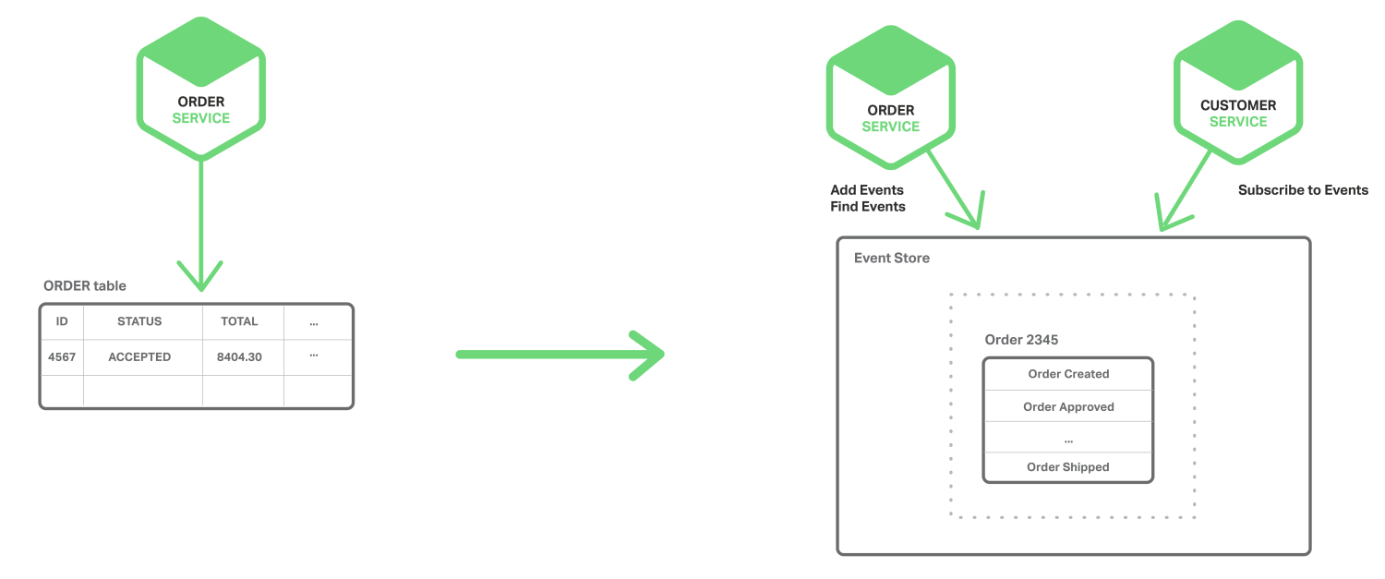
Event Sourcing pattern
Stores a sequence of state-changing events
Events are the source of truth
Events are persisted in an event store
No atomicity needed

Slide 10
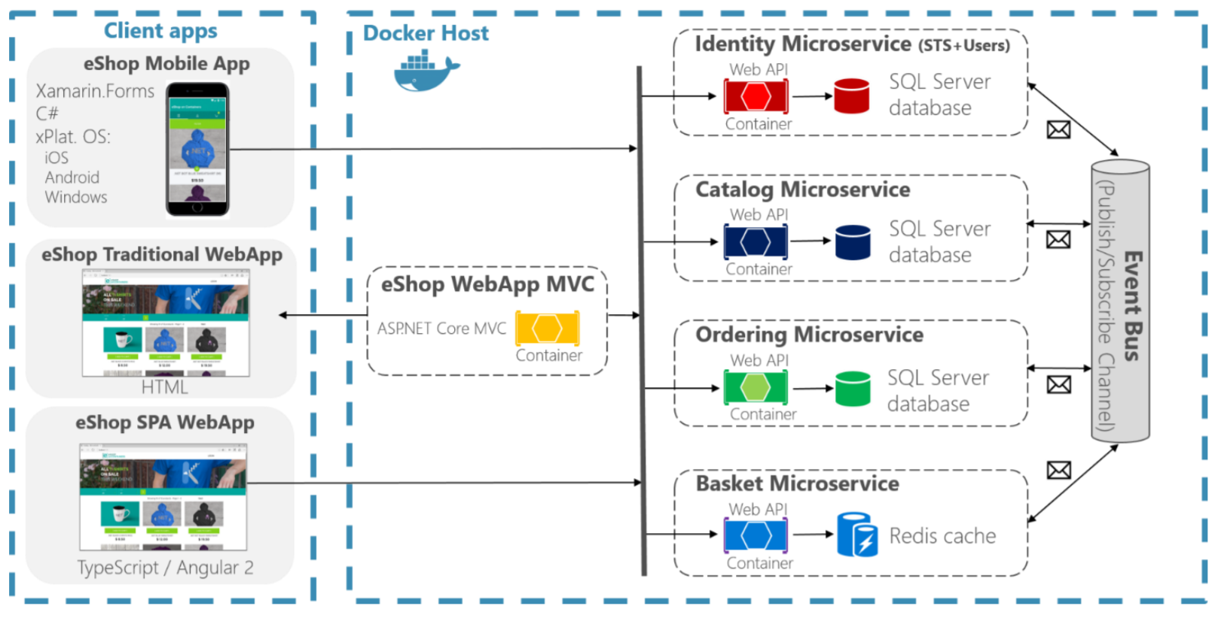
Microservices Communication
Sync communication from app to services
Apps & Services do not orchestrate
Microservices interaction as an asynchronous event-driven communication (choreography)
Avoid synchronous chain calls between services
Use of message queues.
Avoid adding business rules in the queue bus
Idempotency

Slide 11
2. Resilience

Slide 12
Design for failure
System fault tolerant
Services recovers after a network or service failure avoiding downtime or data loss
Use of asynchronous communication
Use of timeouts
Use of retries with exponential backoff policies
Use of Circuit Breaker pattern
Limit the number of queued requests
Health monitoring

Slide 13
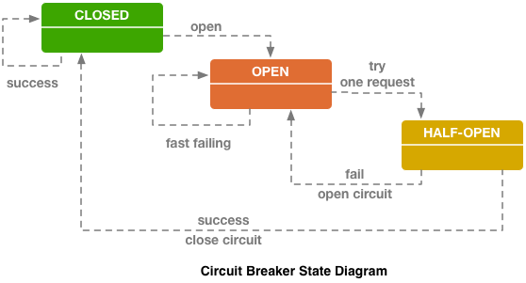
Circuit Breaker Pattern
Protects a function call in a circuit broker objects which monitores for failures
Avoids overloading a strugling service
If the number of failures reach a certain threshold, the circuit changes to Open state and subsequent requests will fail.
After a timeout the circuit changes to Half-open state and makes a trial request.
If successful, the circuit changes to Closed state and subsequent request will be sent.
If not, is changed to Open state again.

Slide 14
3. Infrastructure Automation

Slide 15
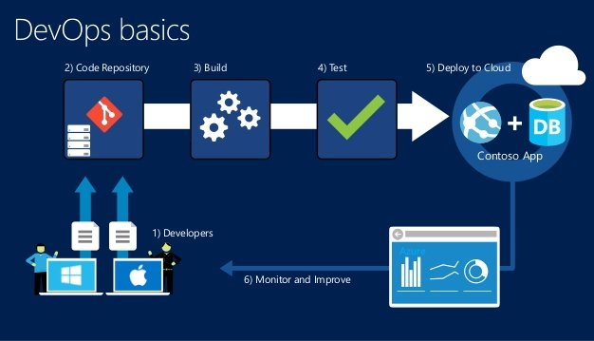
Infrastructure Automation
Adopt DevOps methodology
Automated QA and Deployments
Continous Integration Continuous Deployment (CI/CD)
Faster and independent deliveries

Slide 16
Workshop: adding Circuit Breaker with Polly

Slide 17
4. Health monitoring

Slide 18
The situation
We have lots of instances of our services
A service instance can be down for handling requests but the host be running
We need a way to detect these outages to raise a warning and handle the situation
Move traffic to other instances of the same service
Notify the team
Recycle the service

Slide 19
What is Health monitoring
It is the group of operations and activities related to provide the near-real-time information about the containers and microservices.
Health monitoring is different from diagnostics:
Diagnostics is about tracking and measuring data
Health monitoring is about the state of a service

Slide 20
Container managers
There are programs that automatize the management of our microservices when they are containerized.
Container managers (Kubernetes, Service Fabric, Swarm…) have health monitoring as a built-in feature. They notify when an instance fails and can take actions automatically.
Kubernetes has two kinds of health check, in addition to the detection of application terminated:
Liveness probes: checks if the application is up and running. Case where application is crashed or deadlocked but not terminated. HTTP call serves to probe it is ok.
If detected Liveness fail, pod is restarted.
Readiness probes: checks if the application is ready to serve traffic. It implies that all the dependencies (database, other services) are up and running. It can happen when starting pod, updating, etc.
Traffic will not be sent until the application is ready

Slide 21
Docker
# Test html
healthcheck:
test: ["CMD", "curl", "-f", "http://localhost"]
interval: 1m30s
timeout: 10s
retries: 3
start_period: 40s
Docker already provided status about the containers (Running, Exited, Paused…), but not really about the apps running inside the container
Since Docker version 1.12 and for Cocker compose v 2.1, it provides a health check system for the apps
You can configure several checks to indicate if the application is healthy

Slide 22
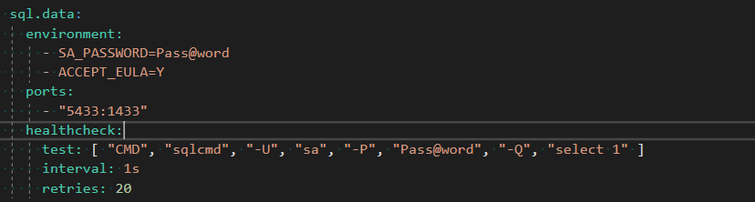
Docker
Another example with database

Slide 23
ASP.NET Core
For custom health checks there exist libraries to add code to our services
For ASP.NET Core we can use HealthChecks from the ASP.NET team. You can download the NuGet package Microsoft.AspNetCore.HealthChecks
It allows several kind of checks, and it is extensible for custom cases.

Slide 24
ASP.NET Core
Setting the check for SQL dependency
At Startup class, when configuring the services
public IServiceProvider ConfigureServices(IServiceCollection services)
{
// Add HealthChecks for SQL server and for Azure Blob storage.
services.AddHealthChecks(checks =>
{
var minutes = 1;
if (int.TryParse(Configuration["HealthCheck:Timeout"], out var minutesParsed))
{
minutes = minutesParsed;
}
// Minutes configures the cache duration
checks.AddSqlCheck("CatalogDb", Configuration["ConnectionString"],
TimeSpan.FromMinutes(minutes));
});
(...)
MS eShopOnContainers

Slide 25
ASP.NET Core
Setting the checks for other services dependencies
At Startup class, when configuring the services
// Add HealthChecks for dependencies of other services.
services.AddHealthChecks(checks =>
{
var minutes = 1;
if (int.TryParse(Configuration["HealthCheck:Timeout"], out var minutesParsed))
{
minutes = minutesParsed;
}
// the CatalogUrlHC would change byt the endpoint, f.i. “http://catalog.api/hc”
checks.AddUrlCheck(Configuration["CatalogUrlHC"], TimeSpan.FromMinutes(minutes));
checks.AddUrlCheck(Configuration["OrderingUrlHC"],TimeSpan.FromMinutes(minutes));
checks.AddUrlCheck(Configuration["BasketUrlHC"], TimeSpan.Zero);
checks.AddUrlCheck(Configuration["IdentityUrlHC"], TimeSpan.FromMinutes(minutes));
checks.AddUrlCheck(Configuration["MarketingUrlHC"],TimeSpan.FromMinutes(minutes));
});
MS eShopOnContainers

Slide 26
ASP.NET Core
Setting the check for the own service
At Startup class, when configuring the services
// Add HealthChecks for service without dependencies
// we need to implement Func<ValueTask<IHealthCheckResult>> check
services.AddHealthChecks(checks =>
{
checks.AddValueTaskCheck("HTTP Endpoint",
() => new ValueTask<IHealthCheckResult>(HealthCheckResult.Healthy("Ok")),
TimeSpan.Zero ); // no cache here, for testing or demo only
});
MS eShopOnContainers

Slide 27
ASP.NET Core
Exposing the HealthCheck endpoint
At Program class, BuildWebHost method
public static IWebHost BuildWebHost(string[] args) =>
WebHost.CreateDefaultBuilder(args)
.UseStartup<Startup>()
.UseApplicationInsights()
// Reporting health status at service address/hc
.UseHealthChecks("/hc")
.UseContentRoot(Directory.GetCurrentDirectory())
.UseWebRoot("Pics")
(...)
MS eShopOnContainers

Slide 28
Workshop: implementing HealthChecks

Slide 29
5. Ready to prod

Slide 30
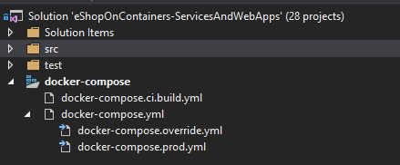
Docker compose: layering
Add specific docker-compose files for different environments
For each environment execute the compose chain starting from docker-compose.yml
Do not put app configuration in setting files (f.i. appsettings.json) because the files are part of he image. Set instead the configuration in Docker-compose files with environment variables.

Slide 31
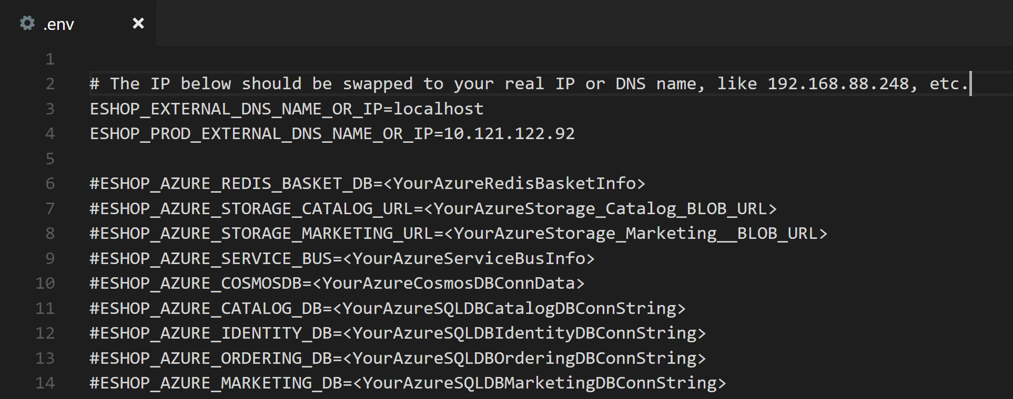
Docker Compose: env variables
Set the configuration values through the environment variables
For Docker-compose use the .env file. Change the values of the .env file during Release for each environment.

Slide 32
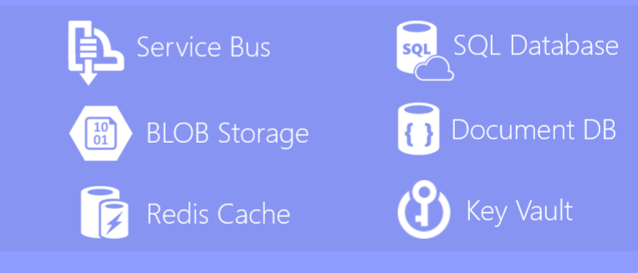
Stateful services
All that has state, goes out of our containerized services
For stateful services we create and consume resources in Azure or equivalent system
Do not store session in the service. Store it a shared store, like Redis or another.
Do not use in-memory data (requests will arrive to different instances)

Slide 33
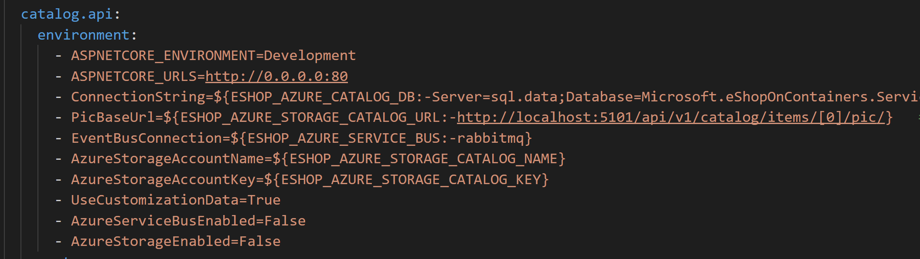
Stateful services
Change the connected resource must be as easy as change the value of one environment variable
--- Local/container service
--- Azure service

Slide 34
Test scaling
There will be multiple instances running
The system must be protected by desing from concurrences
Test with multiple instances of the services to detect concurrency anomalies.
Scale on local with docker compose ‘scale’ parameter: ‘docker-compose scale service_name=5’
Execute load tests with multiple users deploying in orchestrators like Kubernetes with multiple pods
Ensure that the health monitoring is working as expected before going to production
Do not let it for the final phase of development!!

Slide 35
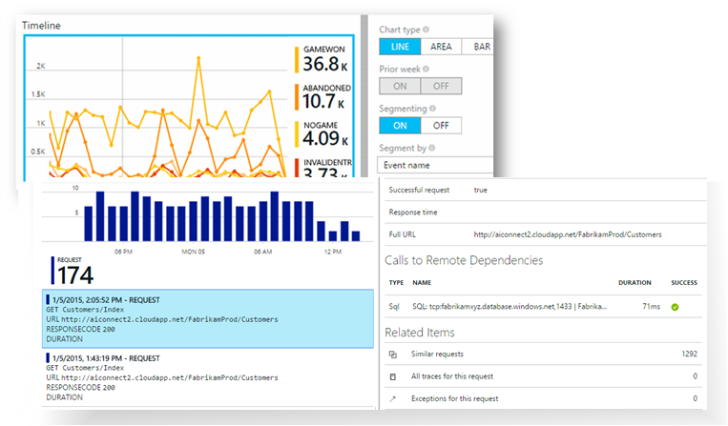
Logs centralized
Logs are automatically send to a centralized system (Application Insights for Azure)
Shared log system for all the services (routing, format, data…) → Accepted coupling in this case
Ensure that all messages/events derived from one request/command share the same correlation ID
Logs can be observed from the service level to the aggregation of the whole system in metrics

Slide 36
CI/CD
Create the CI/CD chains as one of the first tasks in the project.
VSTS is a good tool for that.
Set the values in the Release Management tasks, in the CD, not in config files.
Use secrets and key vaults for sensitive data (Azure Key Vault can be integrated fast with VSTS)
Include your scripts and other configuration files as ARM templates in the repository with the code, to keep it synchronized.
Include test run in the CI/CD

Slide 37
Versioning
Avoid breaking changes as much as possible
REST with json, xml data objects helps to keep messages open to changes
Customers apply the Tolerant reader pattern
Take what you need, do not validate the rest
Avoid assumptions about the structure of the data. Ex: do not set in the reader “/order-history/order-list/order” but take “//order” directly
Implement Tolerant reader in one specific point, and from there inside use a typed DTO
be conservative in what you do, be liberal in what you accept from others.
-- Jon Postel

Slide 38
Versioning
Use semantic version MAJOR.MINOR.PATCH
The version tell to the consumer if is compatible or not
Patch: fix issues → OK
Minor: added functionality, backward compatible → OK
Major: breaking changes, backward incompatible → KO
Recommended in the URI (ex. http://myservice/api/v2.1.2/resources) but it can be passed in the message header

Slide 39
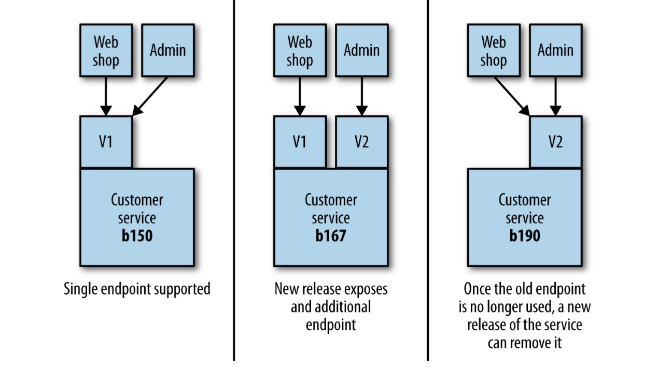
Versioning
Breaking changes: keep the old version temporary through endpoints
Picture by Sam Newman

Slide 40
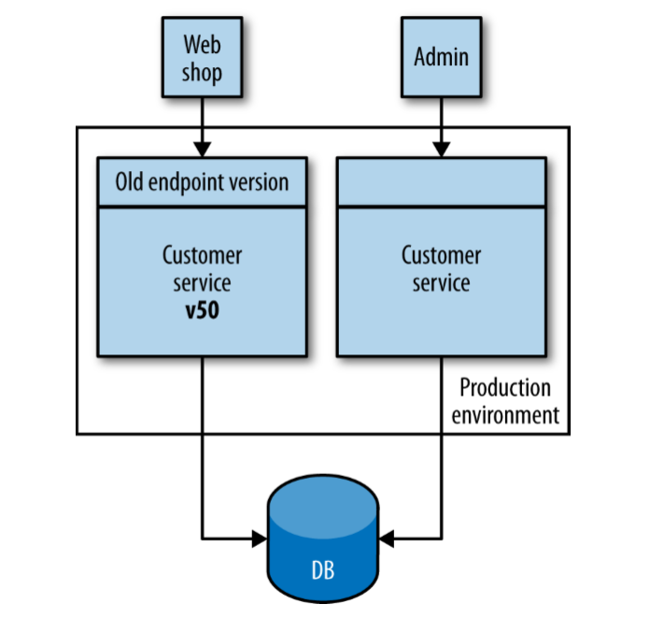
Versioning
Breaking changes: maintain 2 versions of the service
Only for rare cases where one old service cannot be migrated
Adds complexity for maintainability, routing, deployment...
New endpoint version
v59
Picture by Sam Newman

Slide 41
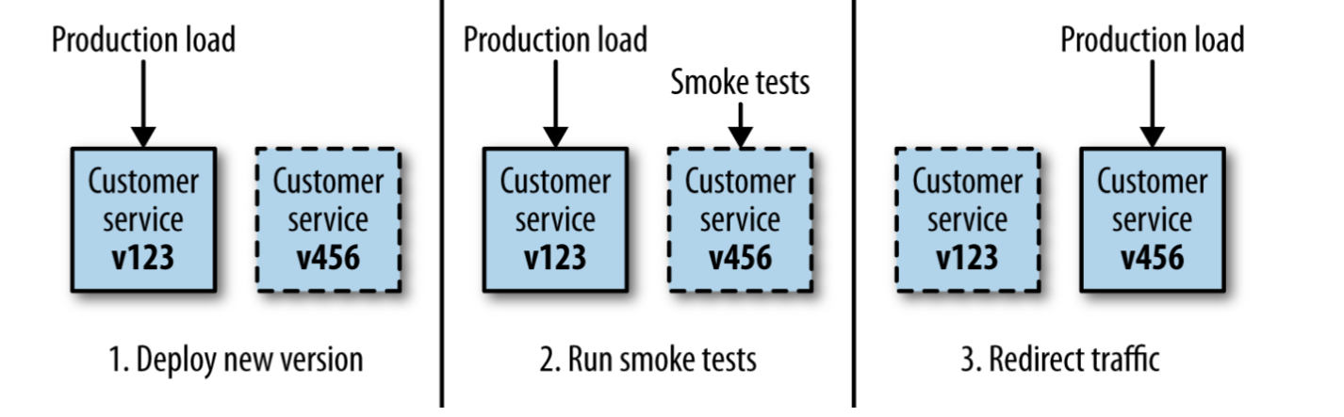
Versioning
Blue/green deployment (separate deployment from release)
Picture by Sam Newman

Slide 42
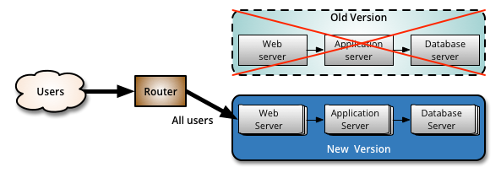
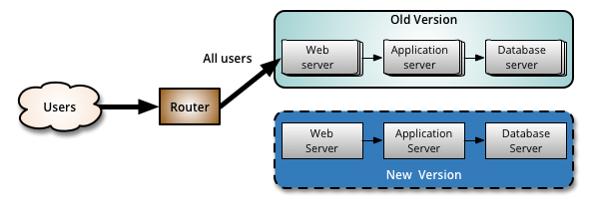
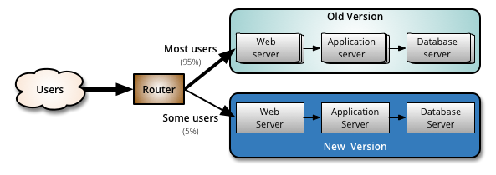
Versioning
Canary deployment, gradually move users to the new version
Pictures by Fowler

Slide 43
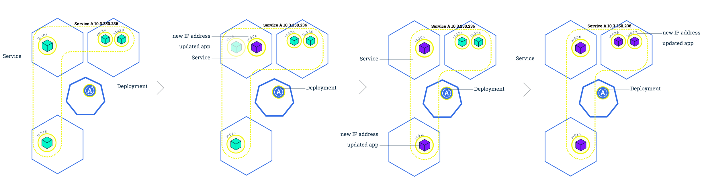
Versioning
Rolling update (typical Kubernetes deployment)

Slide 44
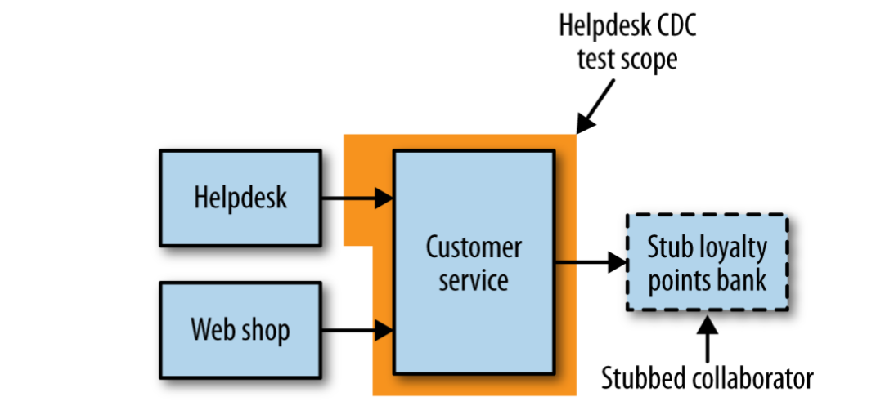
Versioning
CDC Customer driven contract
Problem:
Service changes isolated from its consumers.
Each consumer uses part of the data
How to avoid breaking consumers?
Solution
Customer Driven Contract (CDC) helps to mitigate the breakings
The consumers of our service declare their expectations in form of tests
The tests are run during CI build
If CDC tests are broken, it is forbidden to deploy (customer broken)
CDC is the point for discussions between teams about the common contract (as user stories in Agile)
Picture by Sam Newman

Slide 45
¡Thank you!
www.plainconcepts.com
@plainconcepts

